Slide 1
Software Testing

Slide 2
Verification and Validation
Software testing is one element of a broader topic that is often referred to as verification and validation (V&V).
Verification refers to the set of tasks that ensure that software correctly implements a specific function.
Validation refers to a different set of tasks that ensure that the software that has been built is traceable to customer requirements.
-Verification: “Are we building the product right?”
-Validation: “Are we building the right product?”

Slide 3
Software testing goals:
Software testing process has two distinct goals:
To demonstrate to the clients and the customers that the software meets its requirements.
To discover faults or defects in the software where the behavior of the software is incorrect, undesirable or does not conform to its specification.

Slide 4
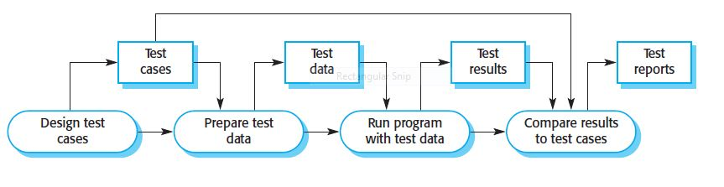
Model of the testing process

Slide 5
Test Case
Test case design is a part of system and component testing where you design the test cases (inputs and predicted outputs) that test the system.
The goal of the test case design process is to create a set of test cases that are effective in discovering program defects and showing that the system meets its requirements.
To design a test case, you select a feature of the system or component that you are testing.
You then select a set of inputs that execute that feature, document the expected outputs or output ranges and, where possible, design an automated check that tests that the actual and expected outputs are the same.

Slide 6
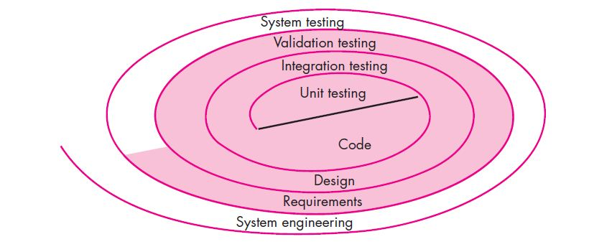
Testing strategy

Slide 7
Software Testing Strategy
A strategy for software testing may also be viewed in the context of the spiral.
Unit testing begins at the vortex of the spiral and concentrates on each unit (e.g., component, class, or WebApp content object) of the software as implemented in source code.
Testing progresses by moving outward along the spiral to integration testing, where the focus is on design and the construction of the software architecture.
Taking another turn outward on the spiral, you encounter validation testing, where requirements established as part of requirements modeling are validated against the software that has been constructed.
Finally, you arrive at system testing, where the software and other system elements are tested as a whole.
To test computer software, you spiral out in a clockwise direction.

Slide 8
Unit Testing
Unit testing focuses verification effort on the smallest unit of software design—the software component or module.
The unit test focuses on the internal processing logic and data structures within the boundaries of a component.
This type of testing can be conducted in parallel for multiple components.

Slide 9
Unit Testing
Local data structures are examined to ensure that data stored temporarily maintains its integrity during all steps in an algorithm’s execution.
All independent paths through the control structure are exercised to ensure that all statements in a module have been executed at least once.
Boundary conditions are tested to ensure that the module operates properly at boundaries established to limit or restrict processing.
And finally, all error-handling paths are tested.

Slide 10
Integration Testing
At the same time integration is occurring, conduct tests to uncover errors associated with interfaces.
Objective is to take unit tested modules and build a program structure based on the prescribed design
Two Approaches
Non-incremental Integration Testing
Incremental Integration Testing

Slide 11
Non-incremental Integration Testing
Commonly called the “Big Bang” approach
All components are combined in advance
The entire program is tested as a whole
Chaos results
Many seemingly-unrelated errors are encountered
Correction is difficult because isolation of causes is complicated
Once a set of errors are corrected, more errors occur, and testing appears to enter an endless loop

Slide 12
Incremental Integration Testing
Three kinds
Top-down integration: Modules are integrated by moving downward through the control hierarchy
Bottom-up integration: Integrating or joining two or more modules by moving upward from bottom to top through control flow of architecture structure
Sandwich integration: combination of bottom-up approach and top-down approach
The program is constructed and tested in small increments
Errors are easier to isolate and correct.

Slide 13
Alpha and Beta Testing
Alpha testing
Conducted at the developer’s site by end users
Software is used in a natural setting with developers watching intently
Testing is conducted in a controlled environment
Beta testing
Conducted at end-user sites
Developer is generally not present
It serves as a live application of the software in an environment that cannot be controlled by the developer
The end-user records all problems that are encountered and reports these to the developers at regular intervals
After beta testing is complete, software engineers make software modifications and prepare for release of the software product to the entire customer base

Slide 14
White Box and Black Box Testing
White Box Testing
White-box testing (also known as clear box testing, glass box testing, transparent box testing, and structural testing) is a method of testing software that tests internal structures or workings of an application, as opposed to its functionality (i.e. black-box testing). In white-box testing an internal perspective of the system, as well as programming skills, are used to design test cases.
Black Box Testing
Black-box testing is a method of software testing that examines the functionality of an application without peering into its internal structures or workings. This method of test can be applied virtually to every level of software testing: unit, integration, system and acceptance

Slide 15
System Testing
System testing is actually a series of different tests whose primary purpose is to fully exercise the computer-based system.
Although each test has a different purpose, all work to verify that system elements have been properly integrated and perform allocated functions.

Slide 16
Different Types of System Testing
Recovery testing:
Many computer-based systems must recover from faults and resume processing with little or no downtime and a system must be fault tolerant.
Recovery testing is a system test that forces the software to fail in a variety of ways and verifies that recovery is properly performed.
If recovery is automatic (performed by the system itself), re-initialization, check-pointing mechanisms, data recovery, and restart are evaluated for correctness.

Slide 17
Different Types of System Testing
Security testing
Verifies that protection mechanisms built into a system will, in fact, protect it from improper access.
Stress testing
Executes a system in a manner that demands resources in abnormal quantity, frequency, or volume.
Performance testing
Tests the run-time performance of software within the context of an integrated system.
Often coupled with stress testing and usually requires both hardware and software instrumentation.
Can uncover situations that lead to degradation and possible system failure.

Slide 18
Debugging Process
Debugging occurs as a consequence of successful testing
It is still very much an art rather than a science
Good debugging ability may be an innate human trait
Large variances in debugging ability exist
The debugging process begins with the execution of a test case
Results are assessed and the difference between expected and actual performance is encountered
This difference is a symptom of an underlying cause that lies hidden
The debugging process attempts to match symptom with cause, thereby leading to error correction

Slide 19
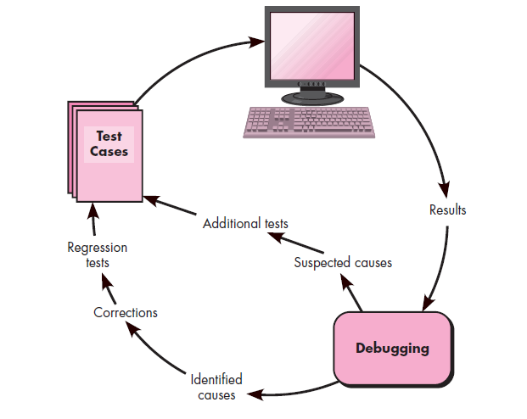
Debugging Process

Slide 20
Why is Debugging so Difficult?
The symptom and the cause may be geographically remote
The symptom may disappear (temporarily) when another error is corrected
The symptom may be caused by human error that is not easily traced
The symptom may be a result of timing problems, rather than processing problems

Slide 21
Debugging Strategies
There are three main debugging strategies
Brute force
Backtracking
Cause elimination

Slide 22
Brute Force
Most commonly used and least efficient method
Used when all else fails
In this method, a printout of all registers and relevant memory locations is obtained and studied
Leads many times to wasted effort and time

Slide 23
Backtracking
Can be used successfully in small programs
The method starts at the location where a symptom has been uncovered
The source code is then traced backward (manually) until the location of the cause is found
Unfortunately, as the number of source lines increases, the number of potential backward paths may become unmanageably large

Slide 24
Cause Elimination
This approach is also called induction and deduction
A list of all possible causes is developed and tests are conducted to eliminate each.
If initial tests indicate that a particular cause hypothesis shows promise, the data are refined in an attempt to isolate the bug.

